Slide 1

Data Analysis on Travel And Tourist Packages
Presented By Uday Deshmukh

Slide 2


About me
Name :- Uday Rambhau Deshmukh
Education :- G. H. Raisoni college of engineering and business management ,Jalgaon.
Why I Want To Learn Data Science :- I want to learn data science because ,I’ve always been curious about how companies makes the decision about what customers likes or dislikes ,that urge of knowing how this decision making works in companies created my interest in data science .
Connect With Me :-
https://www.linkedin.com/in/uday-deshmukh-0a225a34a/
https://github.com/uday212004

Slide 3
Use Case :-
This project uses web scraping and exploratory data analysis (EDA) to analyze travel package data from TravelTriangle.
Identify popular travel destinations based on package availability
Analyze price distribution across different trip durations and hotel ratings
Understand the impact of discounts on package pricing
Segment packages into budget and luxury categories
Provide data-driven insights to support pricing strategy, package planning, and marketing decisions
Objective Of the Project :-
The objective of this project is to collect, clean, and analyze travel package data scraped from the TravelTriangle website in order to identify key trends and patterns related to pricing, trip duration, destinations, hotel ratings, and discounts.
To analyze scraped travel package data using EDA techniques to uncover pricing, destination, and discount trends in the travel and tourism industry.
Through exploratory data analysis, the project aims to generate data-driven insights that can support better decision-making in travel package planning, pricing strategies, and marketing efforts.

Slide 4
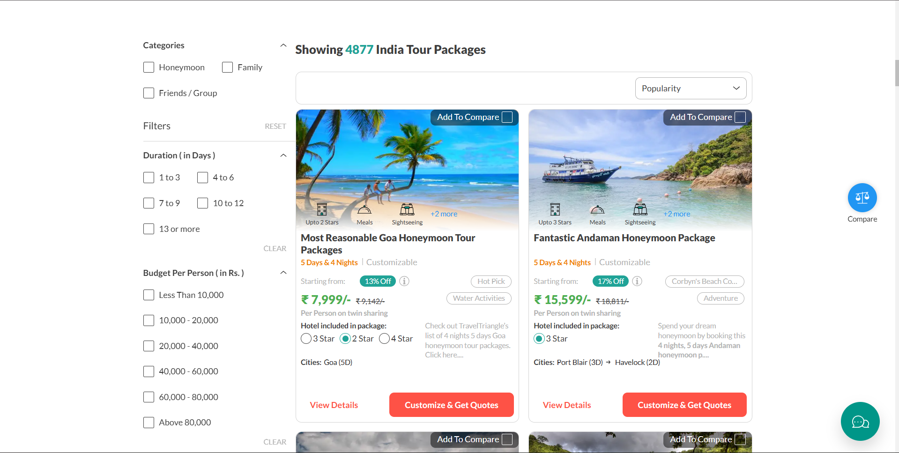
Data Resources
https://traveltriangle.com/tour-packages/india?destination_type=india

Slide 5
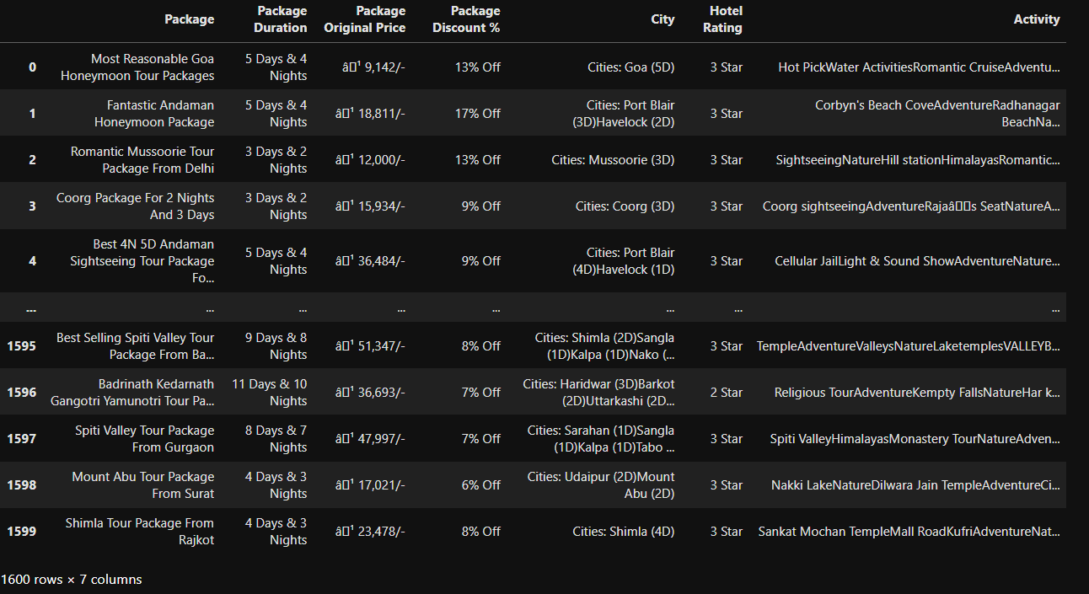
Package Data After Scraping from Site

Slide 6
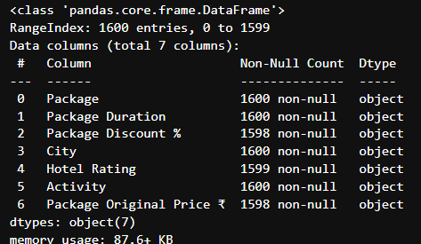
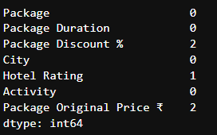
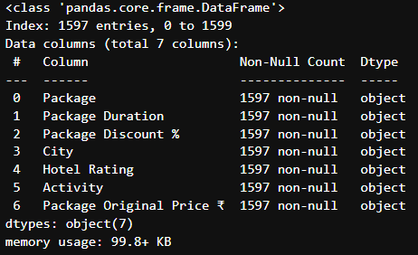
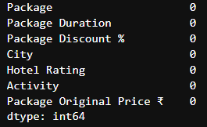
Data Has Missing Values
Count Of Missing Values
After Handling Missing Values and Droping rows
Data has No Missing Values

Slide 7
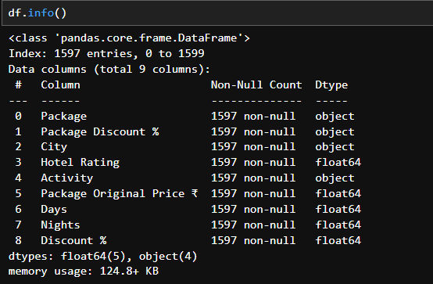
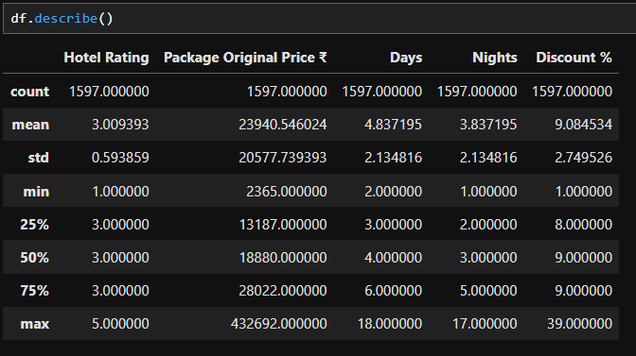
Summary Of Data

Slide 8
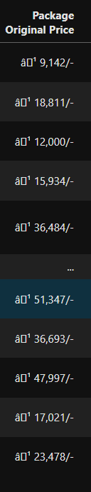
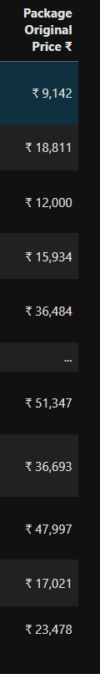
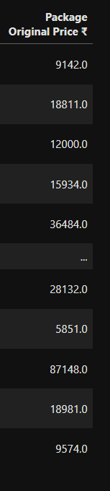
We Clean Package Price
Removed currency symbols (₹) from price

Slide 9
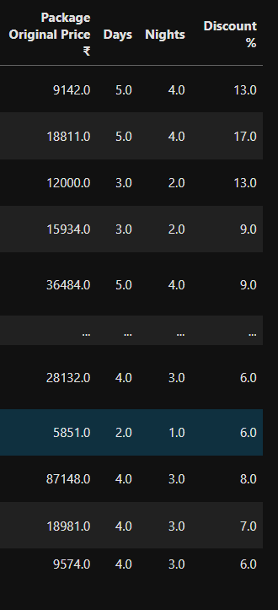
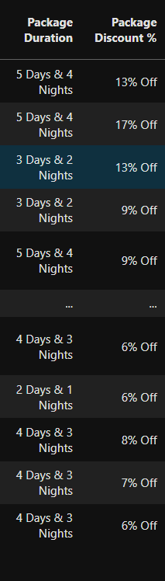

Converted price, discount, days, nights into numeric format
Here, We extracted the numerical values and removed the “str”,”symbols”,”chars”.

Slide 10
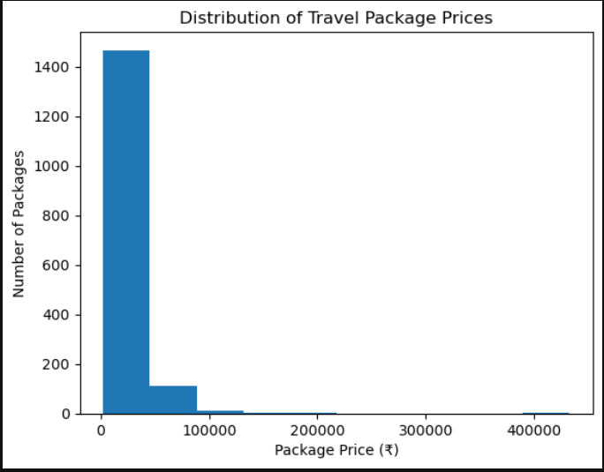
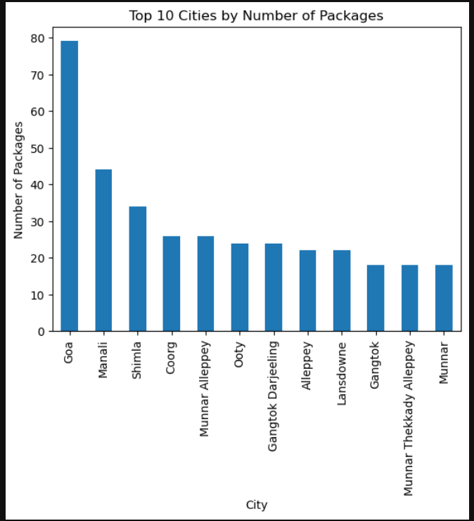
Price Range Analysis of Travel Packages
Identify most popular destinations
Most travel packages are concentrated in the low to mid-price range, with a few high-priced outliers indicating limited premium offerings
Popular tourist destinations have significantly higher package availability compared to other cities.
Travel packages are heavily concentrated in a few high-demand destinations.

Slide 11
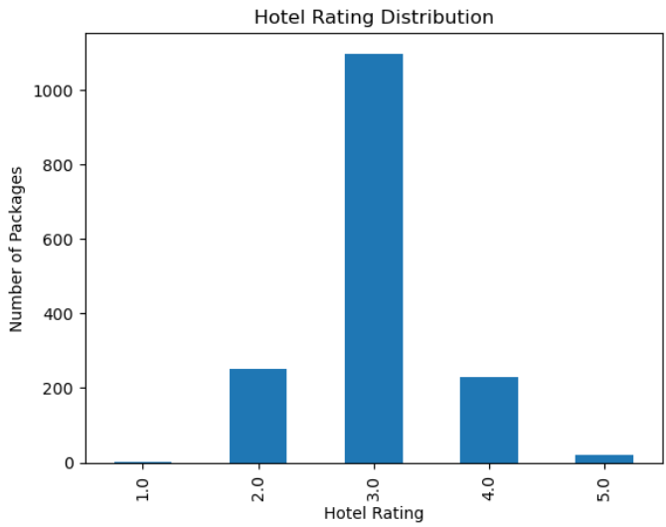
Hotel Rating Analysis
Understand Market Segmentation
Most travel packages include 3-star hotels, showing a preference for economical accommodation.
Packages with 4-star and 5-star hotels are comparatively fewer and cater to a niche segment.

Slide 12
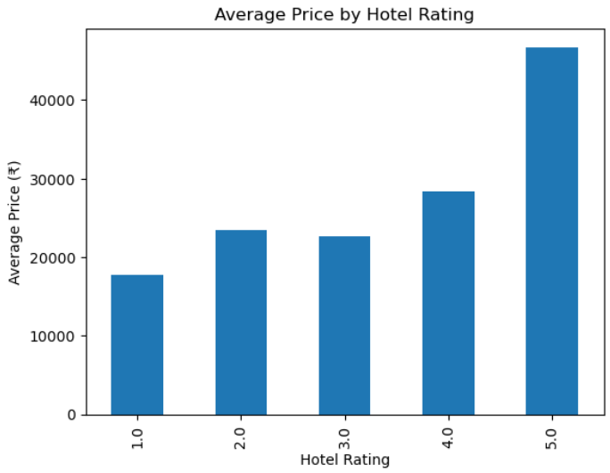
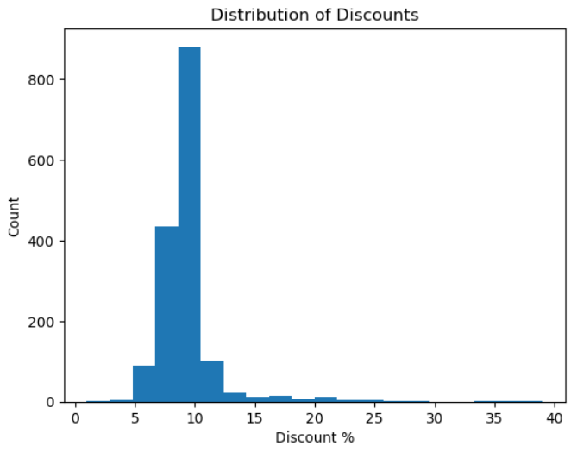
Measure impact of price on rating
Understand Discount Strategies
The average package price increases with hotel rating, showing that higher-rated hotels significantly raise overall travel costs.
Most travel packages offer discounts between 5% and 13%, indicating standardized promotional strategies rather than aggressive price reductions.

Slide 13
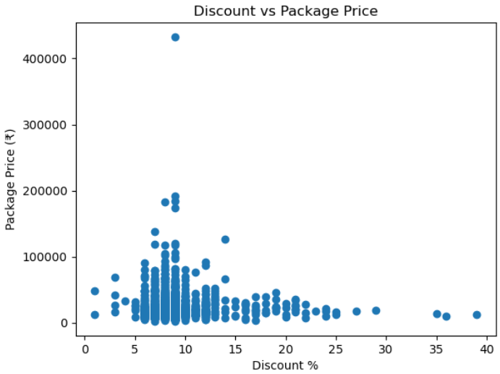
Impact of Discounts on Travel Package Prices
Most discounts lie between 5% and 15%, regardless of package price.
High-priced (luxury) packages generally do not offer very high discounts.
Budget and mid-range packages tend to cluster around common discount values.

Slide 14
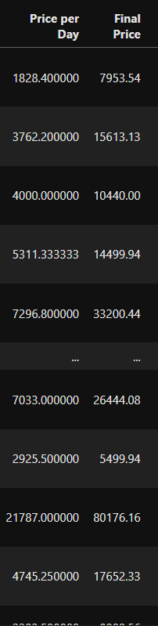
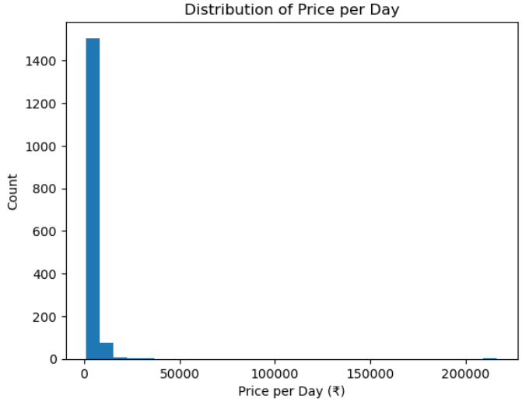
Per Day Price(AVG)
Calculating price per day provides a normalized way to compare packages of different durations.
Many packages offer reasonable daily pricing, making longer trips more cost-effective in some cases.
This metric helps identify true affordability more accurately than total price.

Slide 15
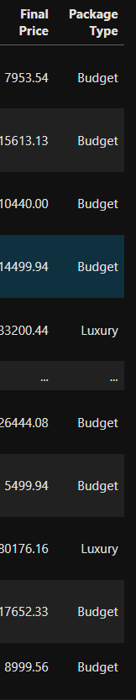
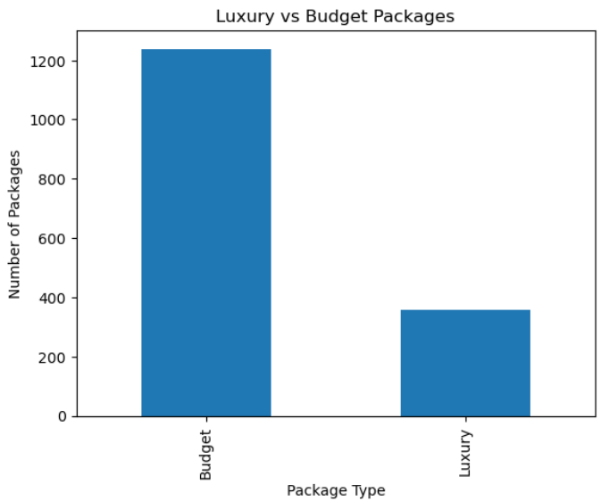
Luxury VS Budget Packages
Most travel packages are designed for affordability rather than premium experiences.
Budget packages dominate the dataset, while luxury packages form a smaller segment, indicating a strong focus on cost-effective travel offerings.
The platform primarily caters to budget travelers, with limited high-end luxury packages.

Slide 16
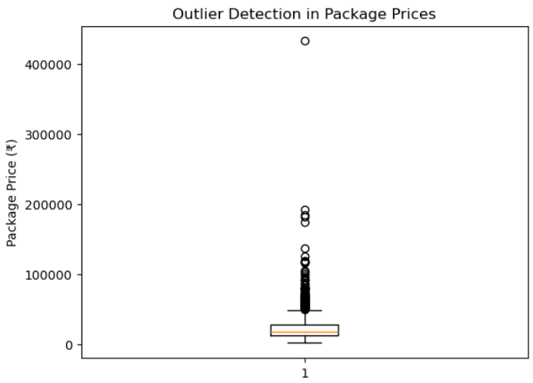
Outlier Detection
Boxplot analysis reveals a small number of high-priced outlier packages.
These packages likely represent luxury experiences, premium hotels, or special destinations.
The majority of packages fall within a consistent and predictable price range.

Slide 17
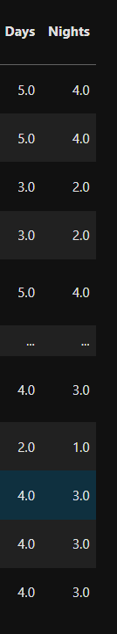
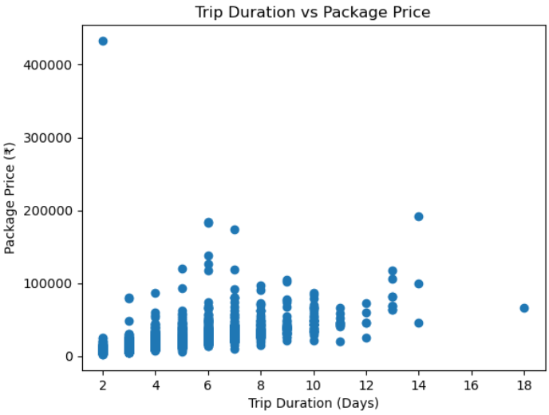
Trip Duration Vs Package Price
There is a positive relationship between the number of days and the package price.
Longer trips generally result in higher overall costs.
Trip duration is one of the key factors influencing package pricing.

Slide 18
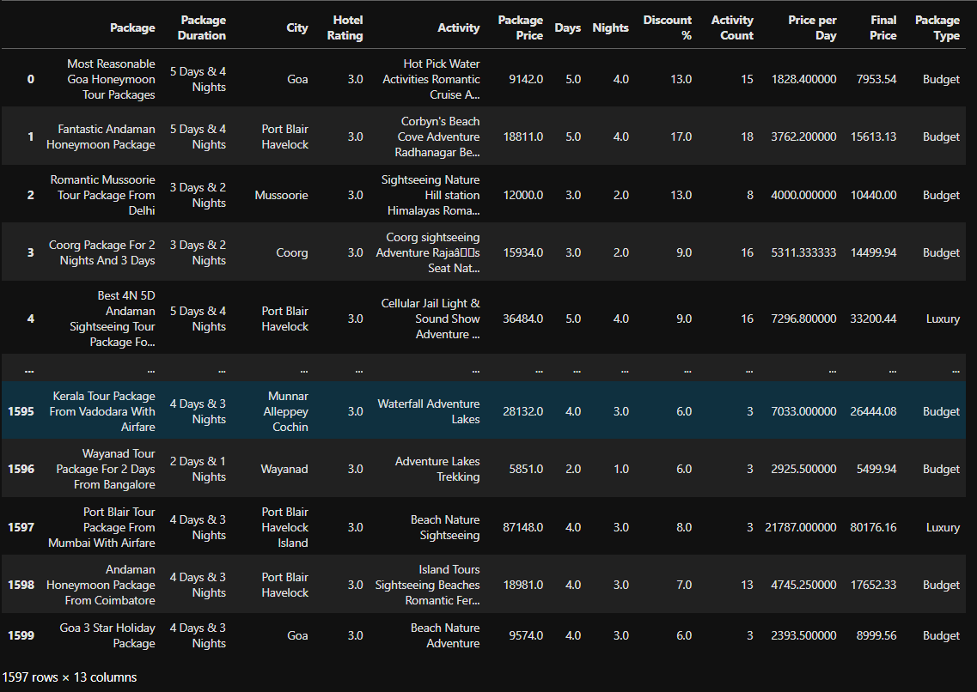
After Performing EDA on the travel & tourism data

Slide 19
Business Value :-
Travel companies design optimized and competitive travel packages.
Marketing teams focus promotions on high-demand destinations.
Pricing teams adjust prices based on duration and hotel rating trends.
Customers make informed decisions by comparing price per day and discounts.
Business Problem :-
Due to the large volume of travel package data, it becomes difficult to manually analyze trends and extract actionable insights for decision-making.
Understanding pricing patterns across destinations and hotel categories.
Identifying popular destinations with high customer demand.
Designing competitive packages that balance cost, duration, and hotel quality.
Applying discount strategies effectively without impacting profitability.

Slide 20
Conclusion
The project aims to analyze scraped travel package data to uncover pricing, destination, and discount trends that support better business and marketing decisions in the travel and tourism domain.
“By scraping and analyzing travel package data, I identified key pricing, destination, and discount trends that can help optimize travel package planning and marketing strategies.”
In this project, travel package data was successfully scraped from the TravelTriangle website and transformed into a clean, structured dataset through effective data cleaning and preprocessing techniques. Exploratory Data Analysis revealed important trends in pricing, trip duration, destination popularity, hotel ratings, and discount strategies. The analysis showed that most travel packages are budget-oriented, focused on popular tourist destinations such as Goa, Manali, and Shimla, and primarily offer 3-star hotel accommodations. Package prices were found to increase with trip duration and hotel rating, while discounts remained relatively consistent across different price ranges. Overall, this project demonstrates how web-scraped data combined with EDA

Slide 21

THANK YOU

